Slide 1
Lab Session 2: MPI / MPJ PageRank
Spring 2012 B534

Slide 2
Overview
MPI / MPJ General functions (From API)
MPJ Global Mean examples
MPI PageRank
Q/A

Slide 3
MPJ general functions
From the Java mpi package:
import mpi.* ;
We use java class Intracomm MPI.COMM_WORLD as our program communicator class.
MPI.Init(args);
Get program input args to MPI;
Only support MPI default optional arguments. E.g. “-np 4”
MPI.COMM_WORLD.Rank();
the rank (id) of current process
MPI.COMM_WORLD.Size();
Get the global total number of processes
MPI.Finalize();
Terminate and finalize this MPJ program
* MPJ Official Java doc: http://mpj-express.org/docs/javadocs/index.html

Slide 4
MPJ I/O functions
MPI.COMM_WORLD.Send
Send user-specified data to destination rank process
Generally, it is used to send splitted data (from one or more nodes. E.g. root process rank 0)
MPI.COMM_WORLD.Recv
Receive data from other ranks processes
* MPJ Official Java doc: http://mpj-express.org/docs/javadocs/index.html

Slide 5
MPJ Sync functions
MPI.COMM_WORLD.Allreduce
Combines values from all processes and distributes the result back to all processes
MPI.COMM_WORLD.Bcast
Broadcasts a message from the process with rank "root" to all other processes of the communicator

Slide 6
MPJ example
Eclipse setting
Demo
/* initialize MPI */
MPI.Init(args);
// the rank (id) of current process
int rank= MPI.COMM_WORLD.Rank();
// the total number of process in the environment
int nProcess= MPI.COMM_WORLD.Size();
/* MPI I/O */
/* Main Body Calculation */
/* MPI finalize */
MPI.Finalize();

Slide 7
MPI Configuration
Create a .mpd.conf under user home directory with one line:
MPD_SECRETWORD=mr45-j9z
Run command: mpd &
Then, run mpirun / mpiexec
[taklwu@polaris ~]$ cat .mpd.conf
MPD_SECRETWORD=mr45-j9z
[taklwu@polaris ~]$ mpd &
[1] 28907
[taklwu@polaris ~]$ mpirun -np 2 mpi_main -i pagerank.input0 -n 10 -t 0.000001

Slide 8
MPJ Configuration
Download the unzip the mpj package, e.g. ~/mpj-v0_38
Set MPJ_HOME and PATH environment parameter to ~/.bashrc
Source and test the environment
Compile and Run MPJ program
[taklwu@polaris ~]$ cat ~/.bashrc
...
export MPJ_HOME=/u/taklwu/mpj-v0_38
export PATH=$MPJ_HOME/bin:$JAVA_HOME/bin:$ANT_HOME/bin:$PATH:.
[taklwu@polaris ~]$ echo $MPJ_HOME
/u/taklwu/mpj-v0_38
[taklwu@polaris ~]$ javac -cp .:$MPJ_HOME/lib/mpj.jar MPIMain.java
[taklwu@polaris ~]$ mpjrun.sh -np 2 MPIMain pagerank.input0 pagerank.output.1000.0 20 0.001

Slide 9
MPI Pagerank
mpi_main
MPI initialization
Pagerank initialization
Global variables
int *adjacency_matrix;
int **am_index;
double *rank_values_table;
int total_num_urls;
int sum_dangling;
mpi_pagerank
MPI_Allreduce()
MPI_Bcast()
mpi_io

Slide 10
Adjacency Matrix
*adjacency_matrix
0
1 2
2 1
3 0 1
4 1 3 5
5 1 4
6 1 4
7 1 4
8 1 4
9 4
10 4
Adjacency_matrix
0 1 2 2 1
am_index
0 | 1
1 | 2
3 | 2
0 1 2 2 1 3 0 1 4 1 3 5
Process 0
am_index[0][0]
am_index[1][0]
am_index[3][0]
am_index[2][0]
Adjacency_matrix
3 0 1 4 1 3 5 5 1 4
am_index
5 | 3
8 | 4
12 | 3
am_index
Process 1
0 | 1
1 | 2
3 | 2
5 | 3
8 | 4
Adjacency_matrix
6 1 4 7 1 4 8 1 4
am_index
15 | 3
18 | 3
21 | 3
Process 2
…

Slide 11
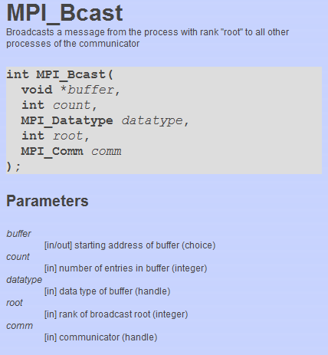
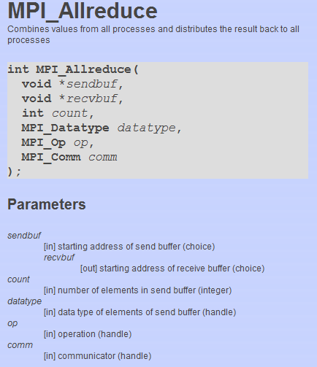
MPI ROUTINES
MPI_Barrier(MPI_COMM_WORLD);

Slide 12
MPI PageRank
int main(int argc, char **argv) {
int numUrls, totalNumUrls;
char *filename;
int **am_index; /* int[numUrls][2], am_index[i][0]refers to index in ajacency_matrix, am_index[i][1] refers to length of urls (one src + its target urls)
int *adjacency_matrix; /* [numTotalWebPages] */
double *rank_values_table; /* [numUrls] */
double threshold;

Slide 13
MPI_Init(&argc, &argv);
MPI_Comm_rank(MPI_COMM_WORLD, &rank);
MPI_Comm_size(MPI_COMM_WORLD, &nproc);
PI_Get_processor_name(mpi_name,&mpi_namelen);
/* Partition - read local adjacency matrix from file */
mpi_read(filename, &numUrls, &am_index, &adjacency_matrix,MPI_COMM_WORLD);
/* Get global numUrls from all processes */
MPI_Allreduce(&numUrls, &totalNumUrls, 1, MPI_INT, MPI_SUM, MPI_COMM_WORLD);
/* assign the initial rank value for each web page */
if (rank == 0) {
double initial_rank = 1.0/(double)totalNumUrls;
for (i=0; i<totalNumUrls; i++)
rank_values_table[i] = initial_rank;
}
/* broad cast the intial rank values to all other compute nodes */
MPI_Bcast(rank_values_table, totalNumUrls, MPI_DOUBLE, 0, MPI_COMM_WORLD);
/* Core computation of MPI PageRank */
mpi_pagerank(adjacency_matrix, am_index, numUrls, totalNumUrls, num_iterations, threshold, rank_values_table, MPI_COMM_WORLD);
mpi_write(filename, totalNumUrls, rank_values_table, MPI_COMM_WORLD);
MPI_Finalize();
return(0);

Slide 14
mpi_pagerank(
double *local_rank_values_table;
double *old_rank_values_table;
do { /* Start of iterations */
for (i=0; i<numUrls; i++) {
for (j=1; j<am_index[i][1]; j++){
// get target_url
// val = pagerank(src_url)/num of target urls of the src url
// add the val to the target url entry of local_rank_values_table
}
if (am_index[i][1] == 1) /* Only itself */
dangling += rank_values_table[src_url];
}
MPI_Allreduce(local_rank_values_table, rank_values_table, count, datatype, op, comm);
MPI_Allreduce(…) // Sum dangling values

Slide 15
Global PageRank and Convergence
if (rank == 0){
/* Pagerank values with damping factor 0.85 */
val = … // dangling value per url
for (i=0; i<total_num_urls; i++)
// update rank_values_table with the dangling value per url and damping factor
/* Calculation of delta */
delta = 0.0;
double diff;
for (i=0;i<total_num_urls;i++){
diff = old_rank_values_table[i] - rank_values_table[i];
delta += diff*diff;
old_rank_values_table[i] = rank_values_table[i];
}
}
/* If delta < threshold, go to next iteration */
if (rank == 0){

Slide 16
Q/A

